Slide 1
OPERATING SYSTEMS & PARALLEL COMPUTING
Disk Management

Slide 2
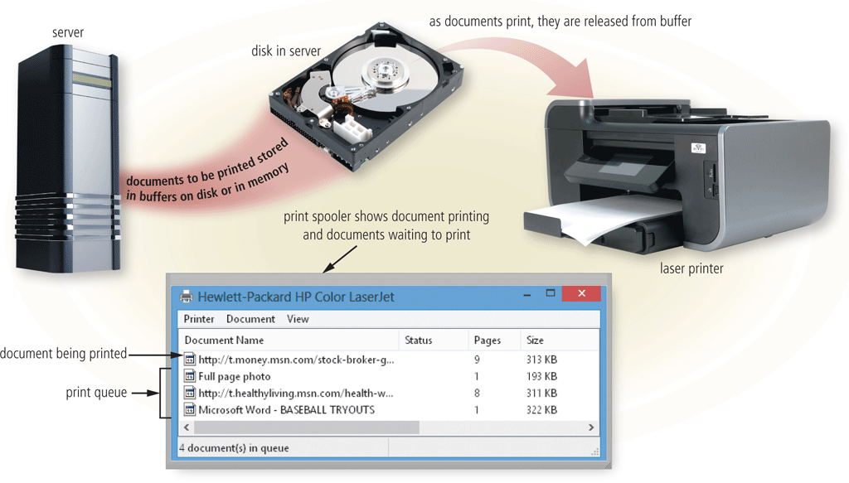
Operating System Functions
The operating system determines the order in which tasks are processed

Slide 3
Operating System Functions
Operating systems often provide users with a variety of tools related to managing a computer, its devices, or its programs
File Manager
Search
Image Viewer
Uninstaller
Disk Cleanup
Disk Defragmenter
Screen Saver
File Compression
PC Maintenance
Backup and Restore

Slide 4
FileSystem Interface

Slide 5
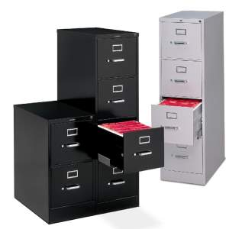
Contents
File Concept
Access Methods
Directory Structures
File System Mounting
File Sharing
Protection

Slide 6
File Concept
Contiguous logical address space.
Types:
Data
numeric
character
binary
Program
Contents defined by file’s creator:
Many types:
Consider text file, source file, executable file

Slide 7
File Structure
None – sequence of words, bytes.
Simple record structure:
Lines
Fixed length
Variable length
Complex Structures:
Formatted document
Relocatable load file
Can simulate last two with first method by inserting appropriate control characters.
Who decides:
Operating system
Program

Slide 8
Basic file attributes
Name – only information kept in human-readable form.
Identifier – unique tag (number) identifies file within system.
Type – needed for systems that support different types.
Location – pointer to file location on device.
Size – current file size.
Protection – controls who can do reading, writing, executing.
Time, date, and user identification – data for protection, security, and usage monitoring.
Information about files are kept in the directory structure, which is maintained on the disk.
Many variations, including extended file attributes such as file checksum.
Information kept in the directory structure.

Slide 9
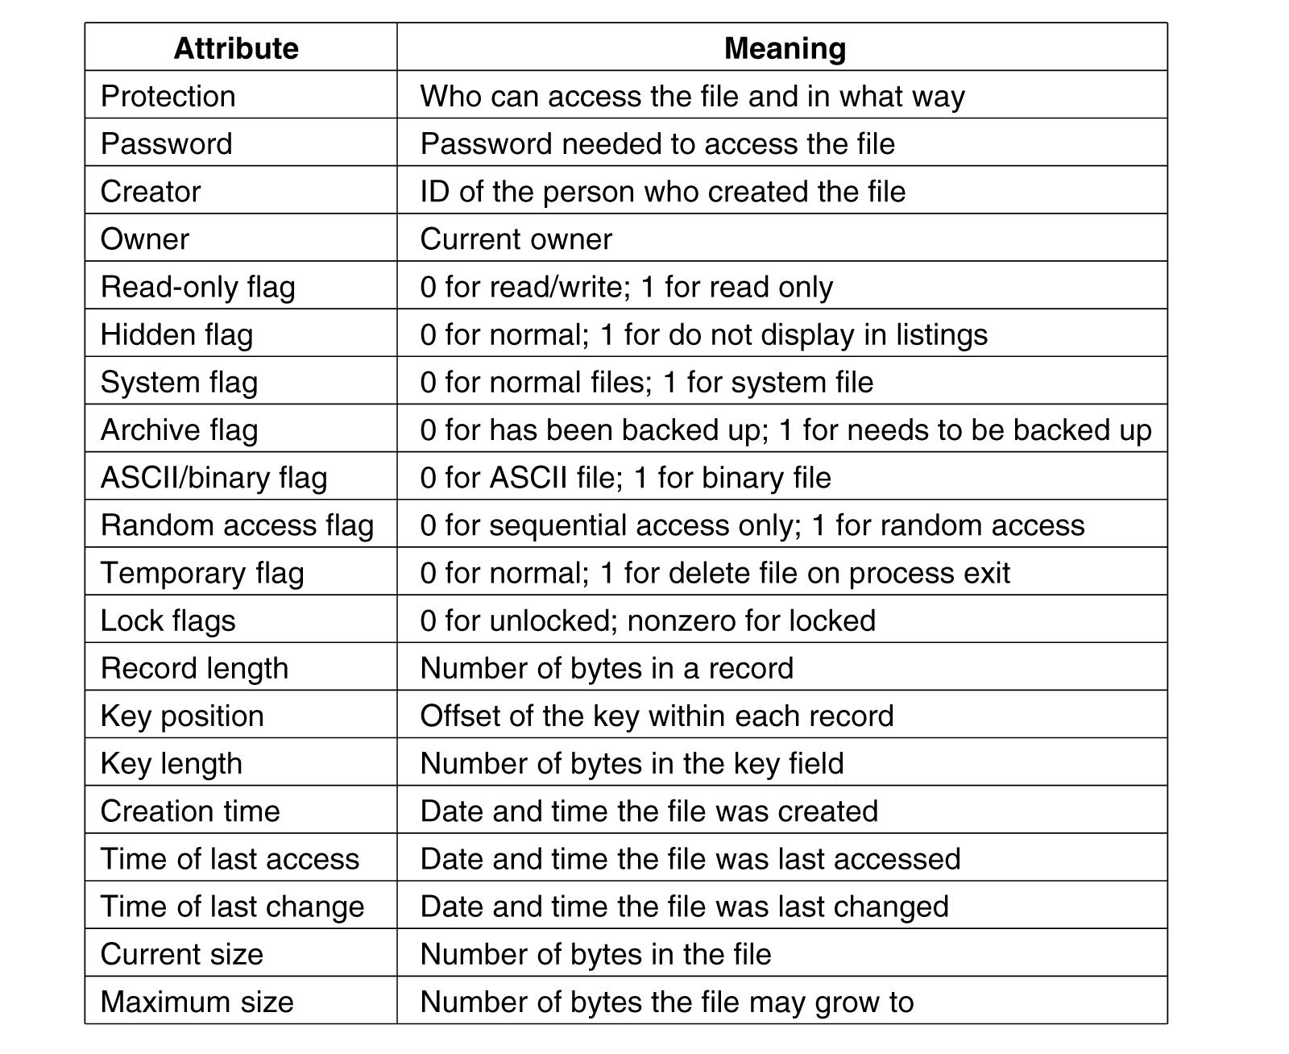
More file attributes

Slide 10
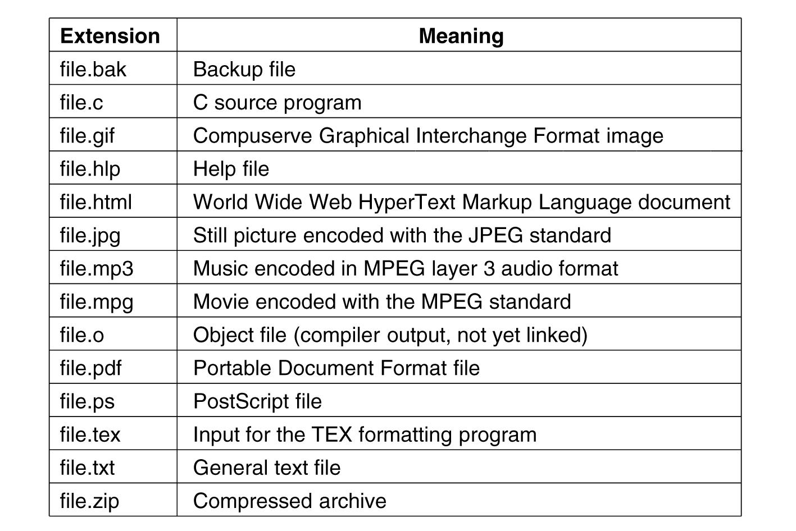
File Type Extensions (1)

Slide 11
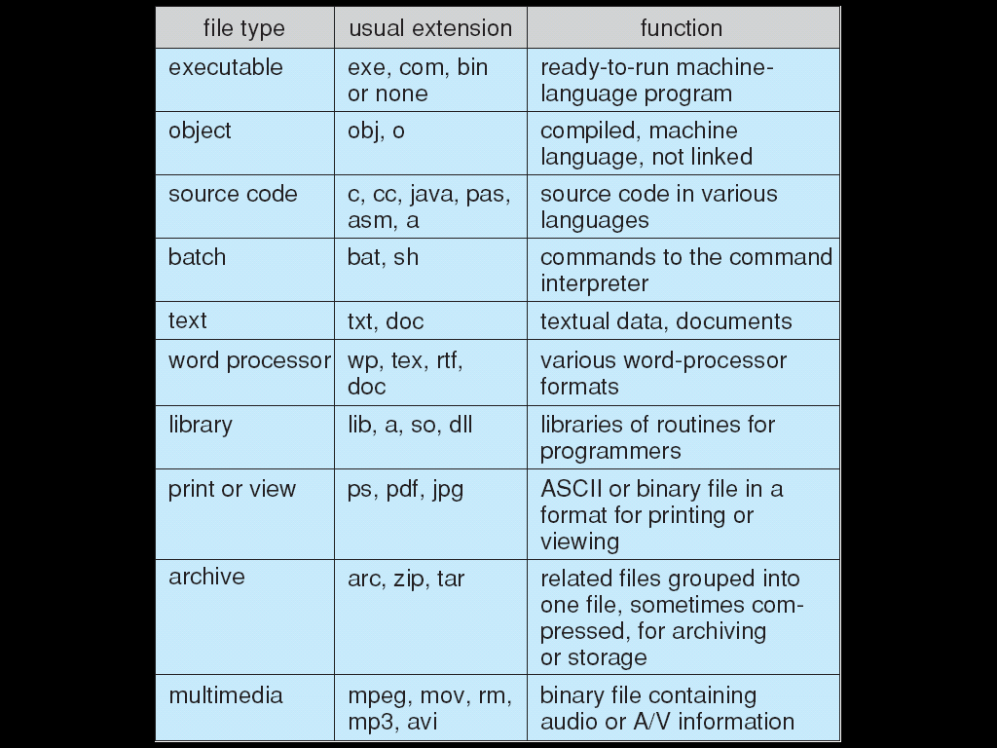
File Type Extensions (2)

Slide 12
Common File Operations
Create
Read/Write – at read/write pointer location.
Seek: Reposition within file.
Delete
Append/Truncate
Set/Get Attributes
Open(F_{i}): search the directory structure on disk for entry F_{i}, and move the content of entry to memory.
Close (F_{i}): move the content of entry F_{i} in memory to directory structure on disk.

Slide 13
Open Files
Several pieces of data needed to manage open files:
Open-file table: tracks open files.
File pointer: pointer to last read/write location, per process that has the file open.
File-open count: counter of number of times a file is open – to allow removal of data from open-file table when last processes closes it.
Disk location of the file: cache of data access information.
Access rights: per-process access mode information.

Slide 14
Access Methods
Sequential Access
read next
write next
reset
no read after last write
(rewrite)
Direct Access – file is fixed length logical records
read n
write n
position to n
read next
write next
rewrite n
n = relative block number

Slide 15
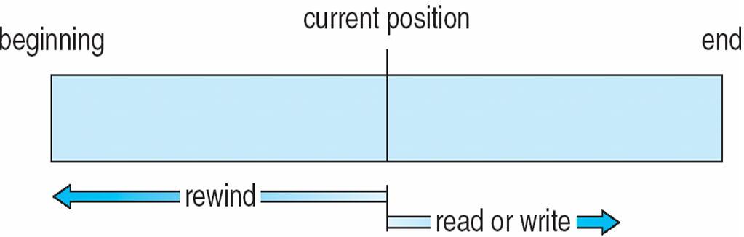
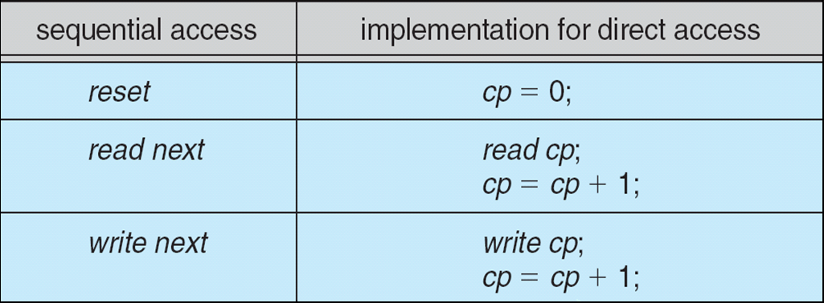
Sequential/Direct Access

Slide 16
Other Access Methods
Can be built on top of base methods.
General involve creation of an index for the file.
Keep index in memory for fast determination of location of data to be operated on (consider UPC code plus record of data about that item).
If too large, index (in memory) of the index (on disk).
IBM indexed sequential-access method (ISAM):
Small master index, points to disk blocks of secondary index
File kept sorted on a defined key
All done by the OS.
VMS operating system provides index and relative files as another example (see next slide).

Slide 17
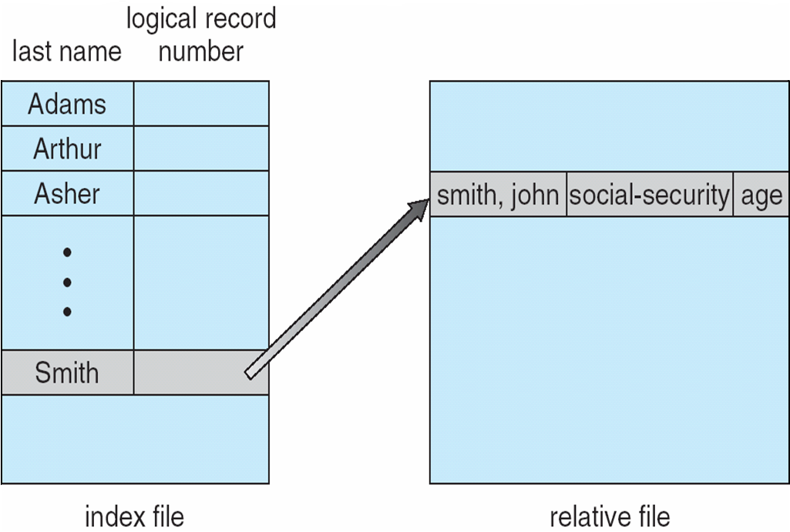
Example of Index and Relative Files

Slide 18
Disk Structure
Disk can be subdivided into partitions.
Disks or partitions can be RAID protected against failure.
Disk or partition can be used raw – without a file system, or formatted with a file system.
Partitions also known as minidisks, slices.
Entity containing file system known as a volume.
Each volume containing file system also tracks that file system’s info in device directory or volume table of contents.
As well as general-purpose file systems, there are many special-purpose file systems, frequently all within the same operating system or computer.

Slide 19
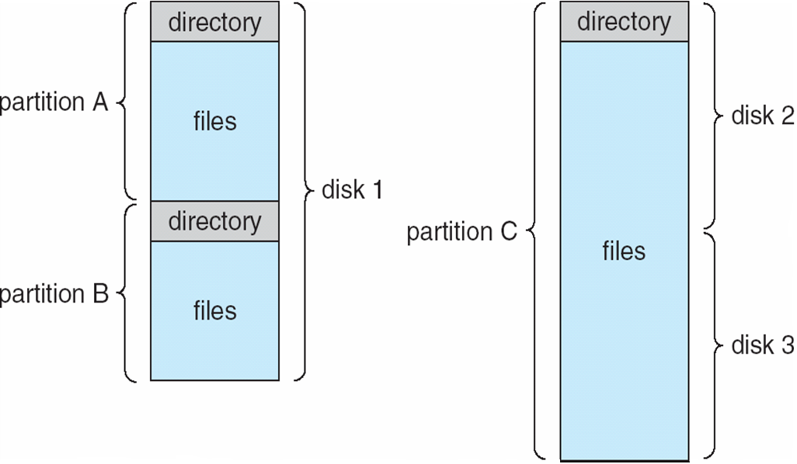
A Typical File-system Organization

Slide 20
Types of File Systems
We mostly talk of general-purpose file systems.
But systems frequently have may file systems, some general- and some special- purpose.
Consider Solaris has:
tmpfs – memory-based volatile FS for fast, temporary I/O
objfs – interface into kernel memory to get kernel symbols for debugging
ctfs – contract file system for managing daemons
lofs – loopback file system allows one FS to be accessed in place of another
procfs – kernel interface to process structures
ufs, zfs – general purpose file systems

Slide 21
Directory Structures
Collection of nodes containing information about all files.
Directory
Files
F 1
F 2
F 3
F 4
F n
Both the directory structure and the files reside on disk.
Backups of these two structures are kept on tapes.

Slide 22
Information in a Directory Entry
Name
Type
Address
Current length
Maximum length
Date last accessed (for archival)
Date last updated (for dump)
Owner ID (who pays)
Protection information

Slide 23
Directory Operations
Operations performed on a directory:
Search for a file
Create a file
Delete a file
List a directory
Rename a file
Traverse the file system

Slide 24
Directory Organization Characteristics
Organize the directory (logically) to obtain:
Efficiency – locating a file quickly.
Naming – convenient to users:
Two users can have same name for different files.
The same file can have several different names.
Grouping – logical grouping of files by properties, (e.g., all Java programs, all games, …).

Slide 25
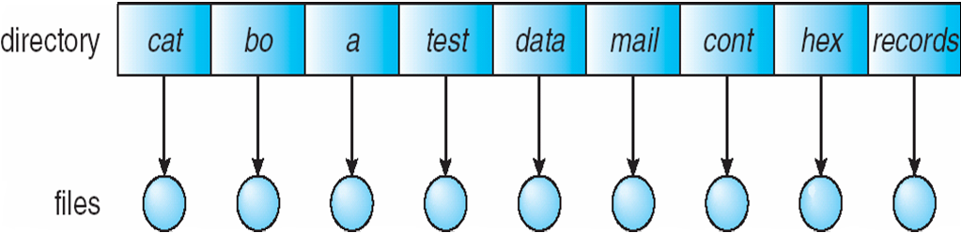
Single-Level Directory
A single directory for all users.
Common problems:
Eventual length of directory.
Giving unique names to files.
Remembering names of files.
Grouping of files (use file extensions).

Slide 26
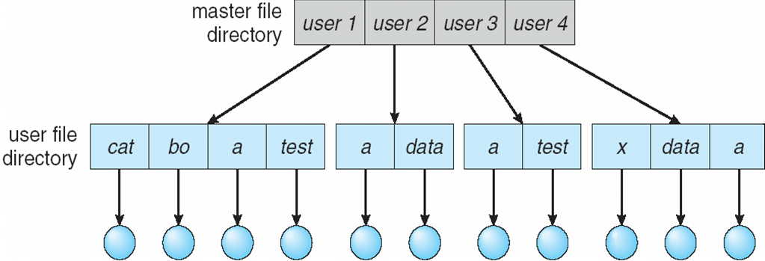
Two-Level Directory
Separate directory for each user.
Use of path name.
Can have the same file name for different users.
Provides efficient searching.
No grouping capability.
Main problem: violates zero-one-infinity principle.

Slide 27
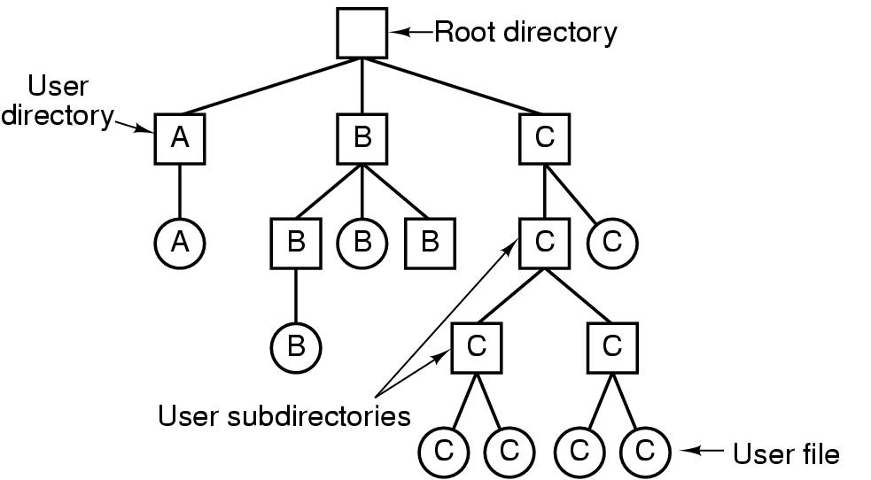
Tree-Structured Directory Components

Slide 28
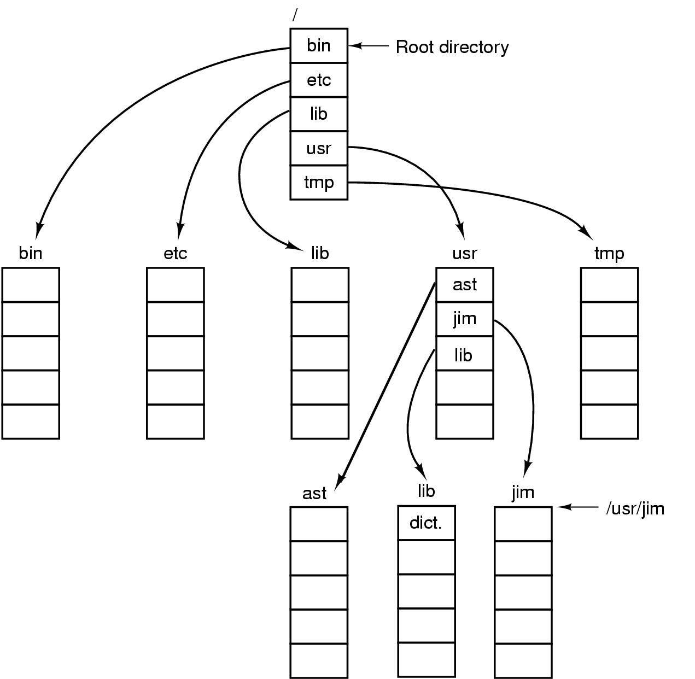
Directory Path Names

Slide 29
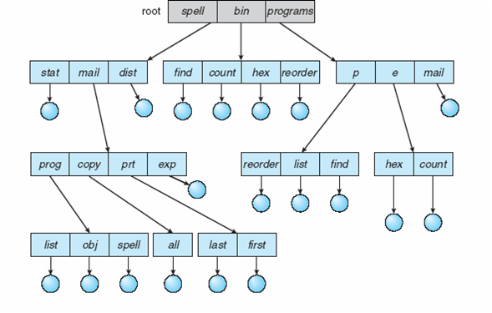
Tree-Structured Directory

Slide 30
Tree-Structured Directories (1)
Provides efficient searching.
Has grouping capability.
Current directory (working directory):
cd /spell/mail/prog
type list
Use absolute or relative path name.

Slide 31
Tree-Structured Directories (2)
Creating a new file is done in current directory.
Delete a file: rm <file-name>
Creating a new subdirectory is done in current directory: mkdir <dir-name>
Example: if in current directory /mail
mkdir count
Deleting “mail” ⇒ deleting the entire subtree rooted by “mail”.
mail
prog
copy
prt
exp
count

Slide 32
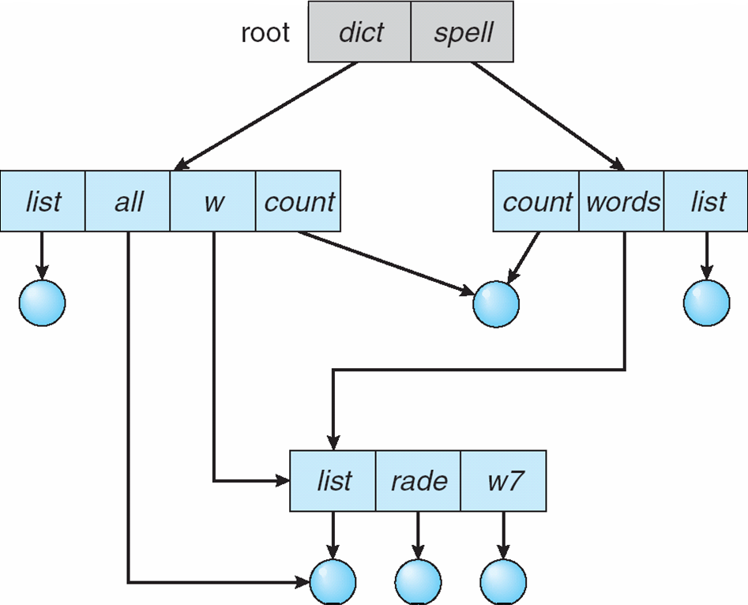
Directed Acyclic Graph (DAG) Directories

Slide 33
Directed Acyclic Graph Directories
Have shared subdirectories and files.
Entry may have two different names (aliasing).
If dict deletes list ⇒ dangling pointer – solutions:
Backpointers, so we can delete all pointers. Variable size records a problem.
Backpointers using a daisy chain organization.
Entry-hold-count solution.
Newer type of directory entry:
Link – another name (pointer) to an existing file
Resolve the link – follow pointer to locate the file

Slide 34
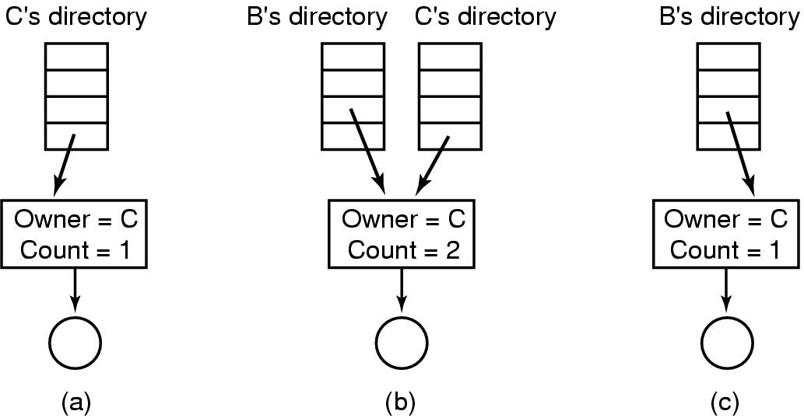
Shared File Example
Situation prior to linking. (b) After the link is created.
(c) After the original owner removes the file.

Slide 35
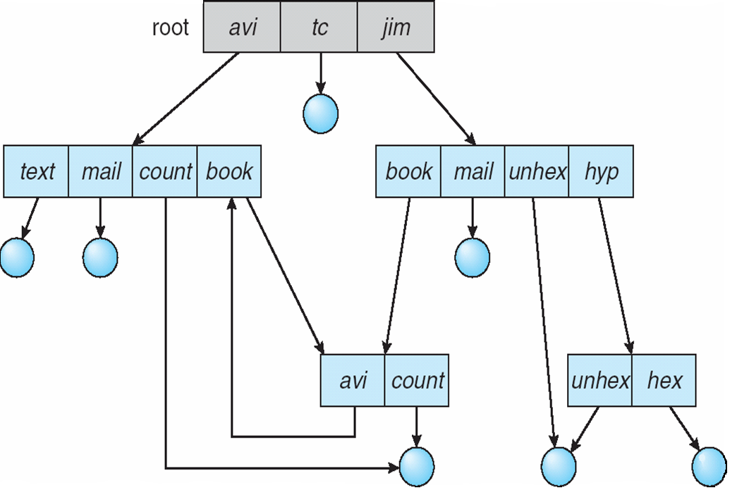
General Graph Directory

Slide 36
General Graph Directory
How do we guarantee no cycles?
Allow only links to files, not subdirectories.
Every time a new link is added use a cycle detection algorithm to determine whether it is OK.
Use garbage collection.

Slide 37
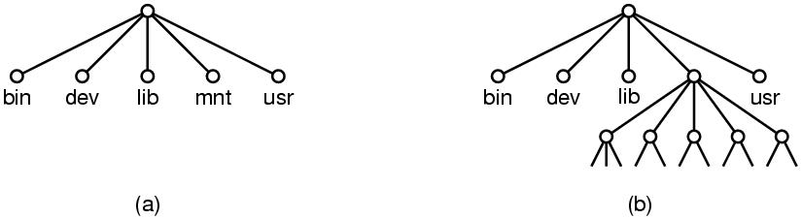
File System Mounting
A file system must be mounted before it can be accessed.
A unmounted file system is mounted at a mount point.

Slide 38
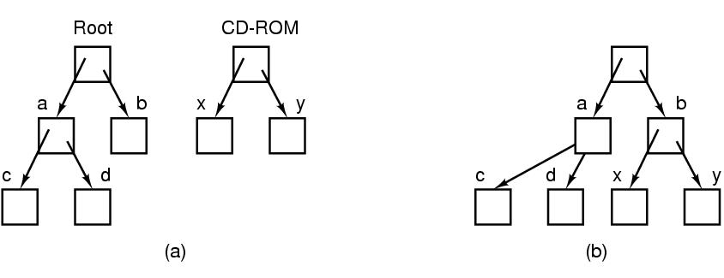
Example – File System Mounting
(a) Before mounting (b) Mounted system

Slide 39
File Sharing
Sharing of files on multi-user systems is desirable.
Sharing may be done through a protection scheme.
On distributed systems, files may be shared across a network.
Network File System (NFS) is a common distributed file-sharing method.
If multi-user system:
User IDs identify users, allowing permissions and protections to be per-user.
Group IDs allow users to be in groups, permitting group access rights.
Owner/Group of a file/directory.

Slide 40
File Sharing – Remote File Systems
Uses networking to allow file system access between systems:
Manually via programs like FTP.
Automatically, seamlessly using distributed file systems.
Semi automatically via the Web.
Client-server model allows clients to mount remote file systems from servers:
Server can serve multiple clients.
Client & user-on-client identification is insecure/complicated.
NFS is standard UNIX client-server file sharing protocol.
CIFS is standard Windows protocol.
Standard operating system file calls are translated into remote calls.
Distributed Information Systems (distributed naming services) such as LDAP, DNS, NIS, Active Directory implement unified access to information needed for remote computing.

Slide 41
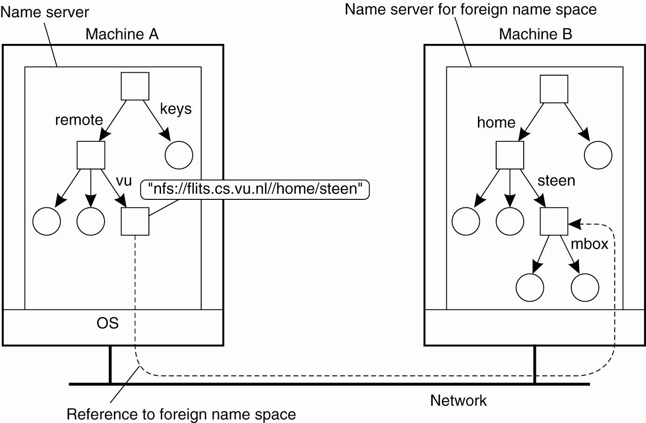
Mounting Remote Name Spaces

Slide 42
File Sharing – Failure Modes
All file systems have failure modes:
For example corruption of directory structures or other non-user data, called metadata.
Remote file systems add new failure modes, due to network failure, server failure.
Recovery from failure can involve state information about status of each remote request.
Stateless protocols such as NFS v3 include all information in each request, allowing easy recovery but less security.

Slide 43
Protection
File owner/creator should be able to control:
what can be done
and by whom
Types of access:
Read
Write
Execute
Append
Delete
List

Slide 44
Access Lists and Groups
Mode of access: read, write, execute
Three classes of users: RWX
a) owner access 7 ⇒ 1 1 1 RWX
b) group access 6 ⇒ 1 1 0
RWX
c) public access 1 ⇒ 0 0 1
Ask manager to create a group (unique name), say G, and add some users to the group.
For a particular file (say game) or subdirectory, define an appropriate access.
Attach a group to a file
owner
group
public
chmod
761
game
chgrp G game

Slide 45
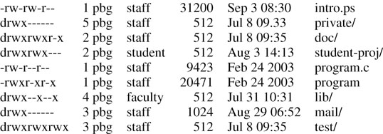
A Sample UNIX Directory Listing

Slide 46
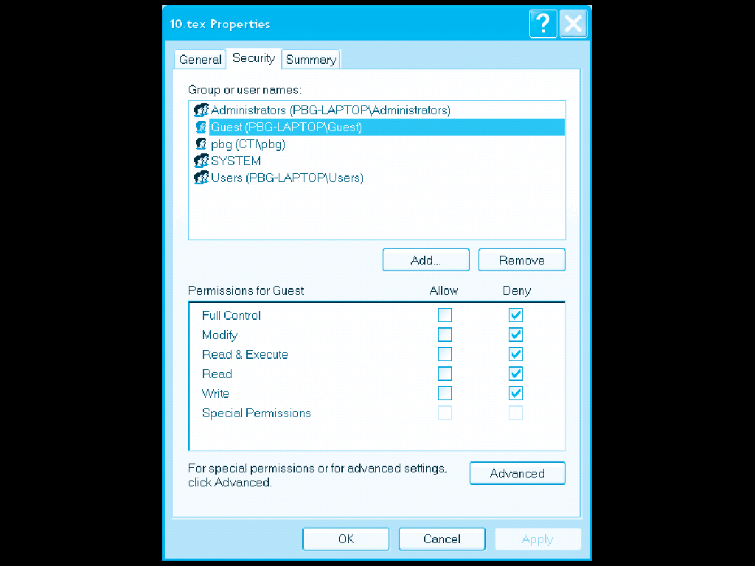
Windows XP Access-control List Management

Slide 47
File System Implementation

Slide 48
File System Implementation
File-System Structure
File-System Implementation
Allocation Methods
Free-Space Management
Efficiency and Performance
Recovery

Slide 49
File-System Structure
File structure:
Logical storage unit
Collection of related information
File system resides on secondary storage (disks):
Provided user interface to storage, mapping logical to physical.
Provides efficient and convenient access to disk by allowing data to be stored, located retrieved easily.
Disk provides in-place rewrite and random access:
I/O transfers performed in blocks of sectors (usually 512 bytes).
File control block – storage structure consisting of information about a file.
Device driver controls the physical device.
File system organized into layers.

Slide 50
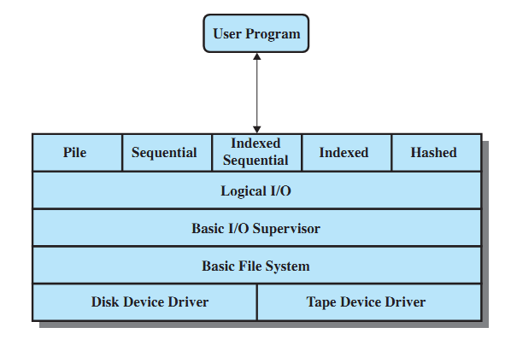
File System Software Architecture

Slide 51
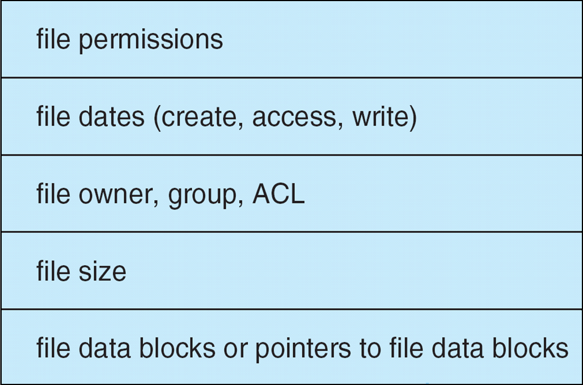
A Typical File Control Block (FCB)

Slide 52
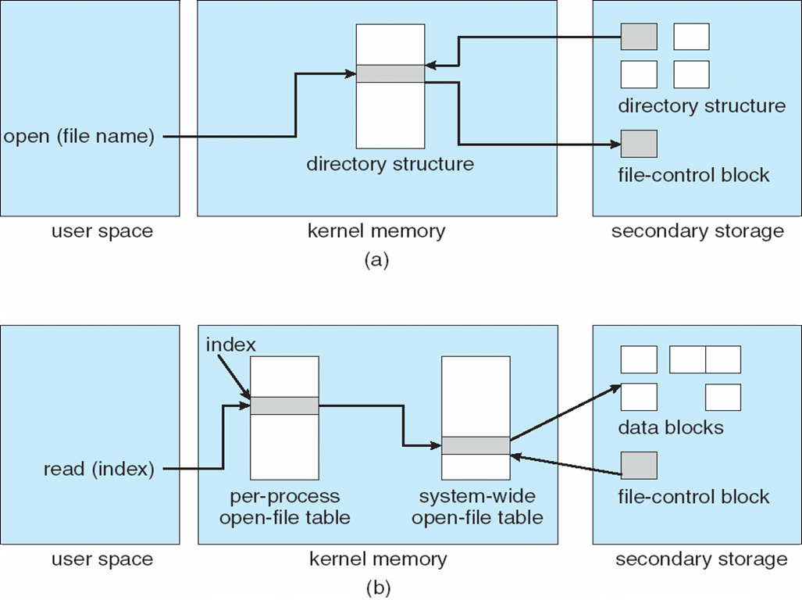
In-Memory File System Structures
(a) Opening a file
(b) Reading a file

Slide 53
Virtual File Systems
Virtual File Systems (VFS) provide an object-oriented way of implementing file systems.
VFS allows the same system call interface (the API) to be used for different types of file systems.
The API is to the VFS interface, rather than any specific type of file system.
Notes:
53

Slide 54
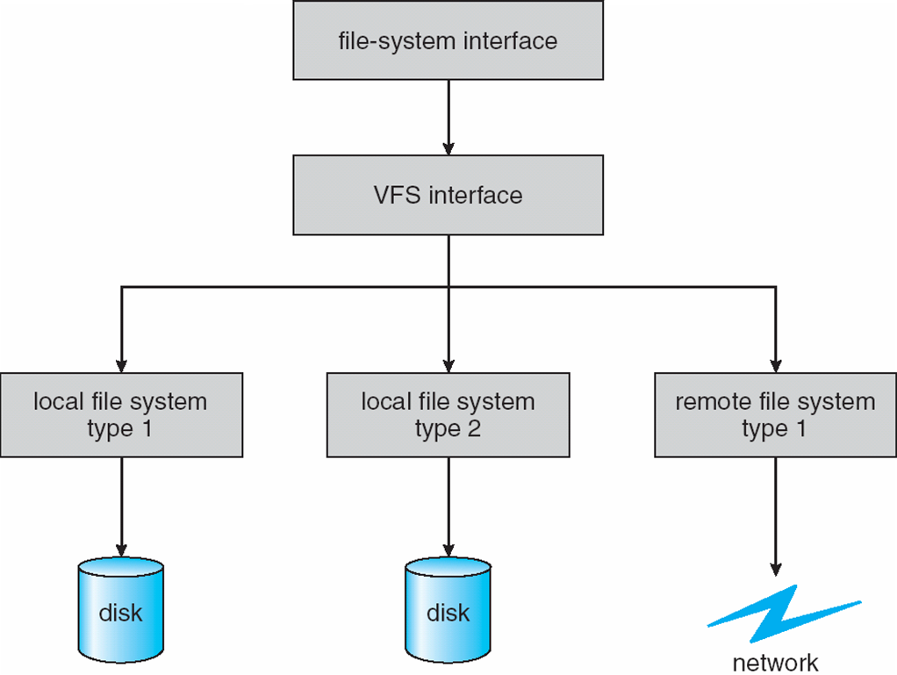
Schematic View of Virtual File System
Notes:
54

Slide 55
Allocation Methods
An allocation method refers to how disk blocks are allocated for files:
Contiguous allocation
Chained/Linked allocation
Indexed allocation
Combined schemes

Slide 56
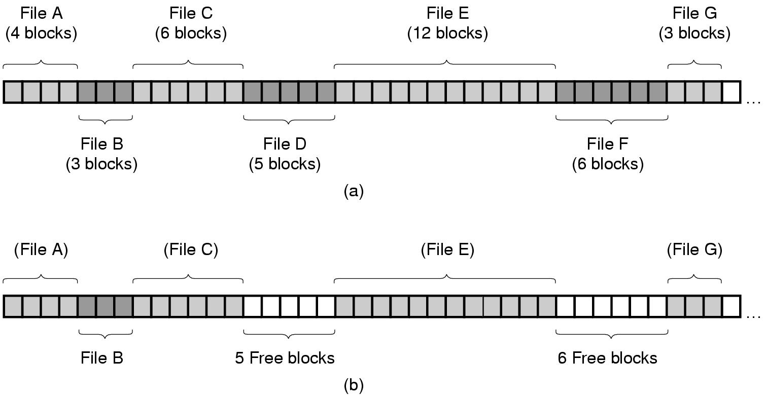
Contiguous Allocation Example
(a) Contiguous allocation of disk space for 7 files.
(b) The state of the disk after files D and F have been removed.

Slide 57
Contiguous Allocation
Each file occupies a set of contiguous blocks on the disk.
Simple: only starting location (block #) and length (number of blocks) required.
Enables random access.
Wasteful of space (dynamic storage-allocation problem).
Files cannot grow.

Slide 58
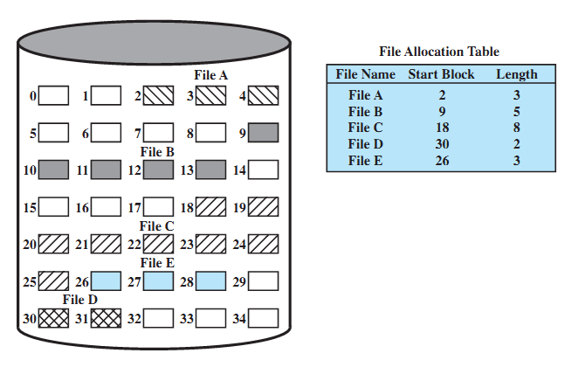
Contiguous File Allocation Example

Slide 59
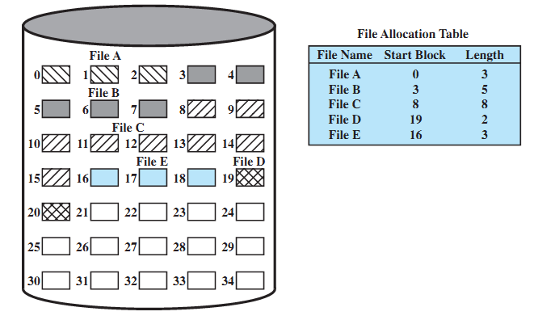
Contiguous file allocation (after compaction)

Slide 60
Extent-Based Systems
Many newer file systems (i.e., Veritas File System) use a modified contiguous allocation scheme.
Extent-based file systems allocate disk blocks in extents.
An extent is a contiguous block of disks:
Extents are allocated for file allocation.
A file consists of one or more extents.

Slide 61
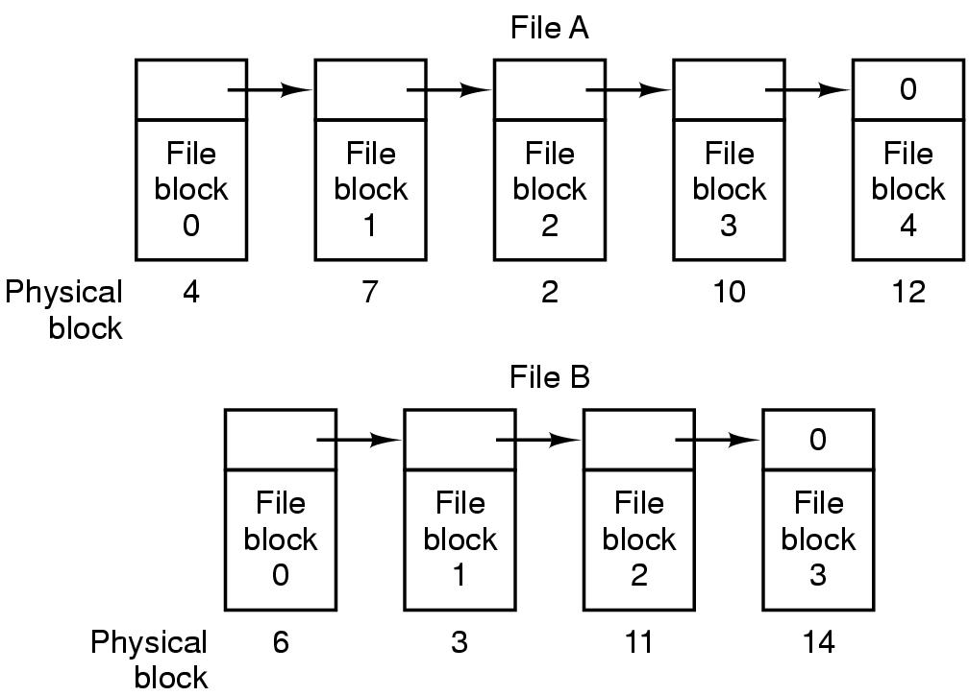
Chained/Linked Allocation Example

Slide 62
Chained Allocation
Each file is a linked list of disk blocks: blocks may be scattered anywhere on the disk.
Simple: need only starting address.
Free-space management: no waste of space.
No random access.
block =
pointer

Slide 63
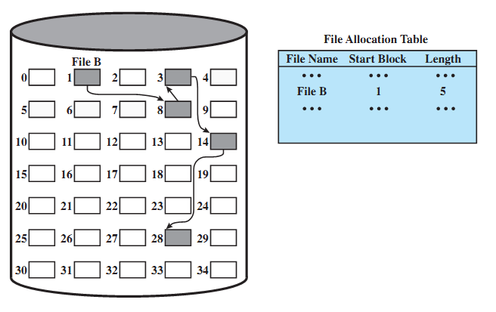
Chained File Allocation Example

Slide 64
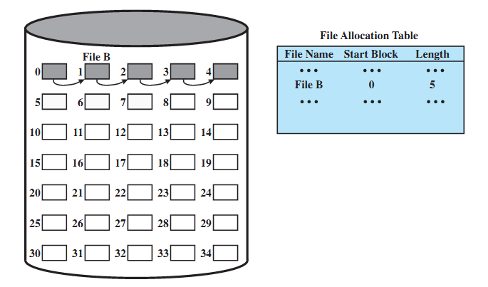
Chained File Allocation (after consolidation)

Slide 65
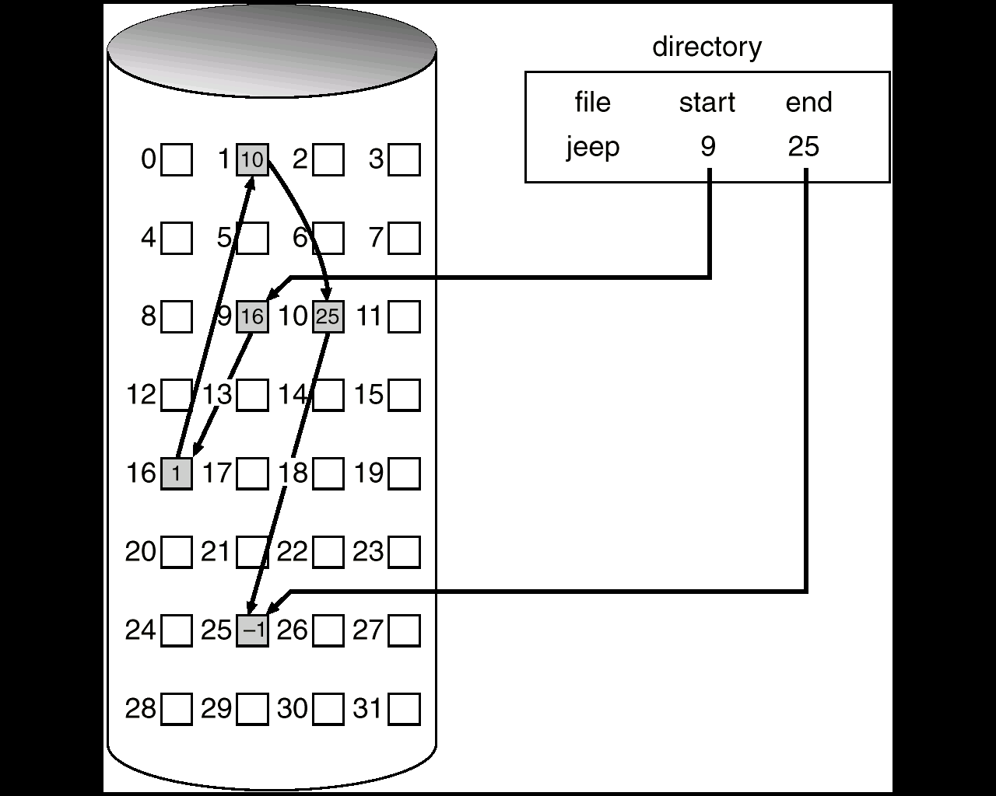
Another Chained Allocation Example

Slide 66
Linked List Allocation Using a Table in Memory

Slide 67
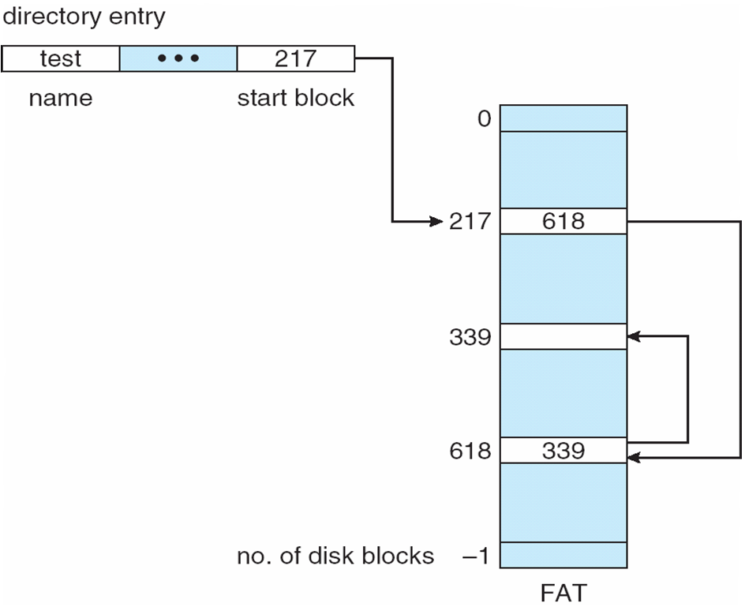
File-Allocation Table (FAT) Example

Slide 68
Indexed Allocation
Brings all pointers together into the index block.
It’s a logical view.
Need index table.
Provides random access.
Dynamic access without external fragmentation, but have overhead of index block.
index table

Slide 69
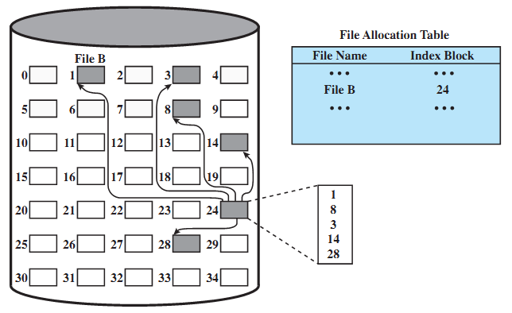
Indexed File Allocation Example

Slide 70
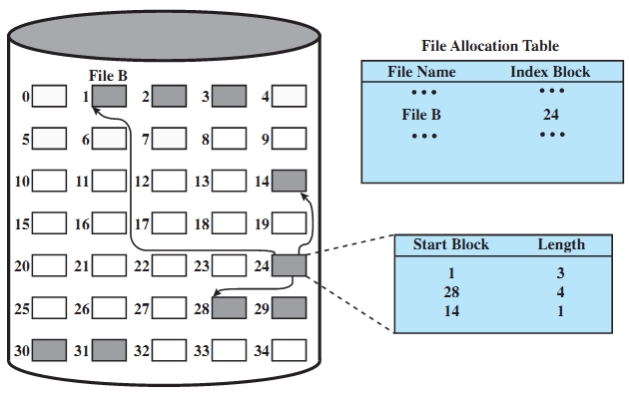
Indexed File Allocation (variable-size)

Slide 71
Indexed Allocation Mapping Example

outer-index
index table
file

Slide 72
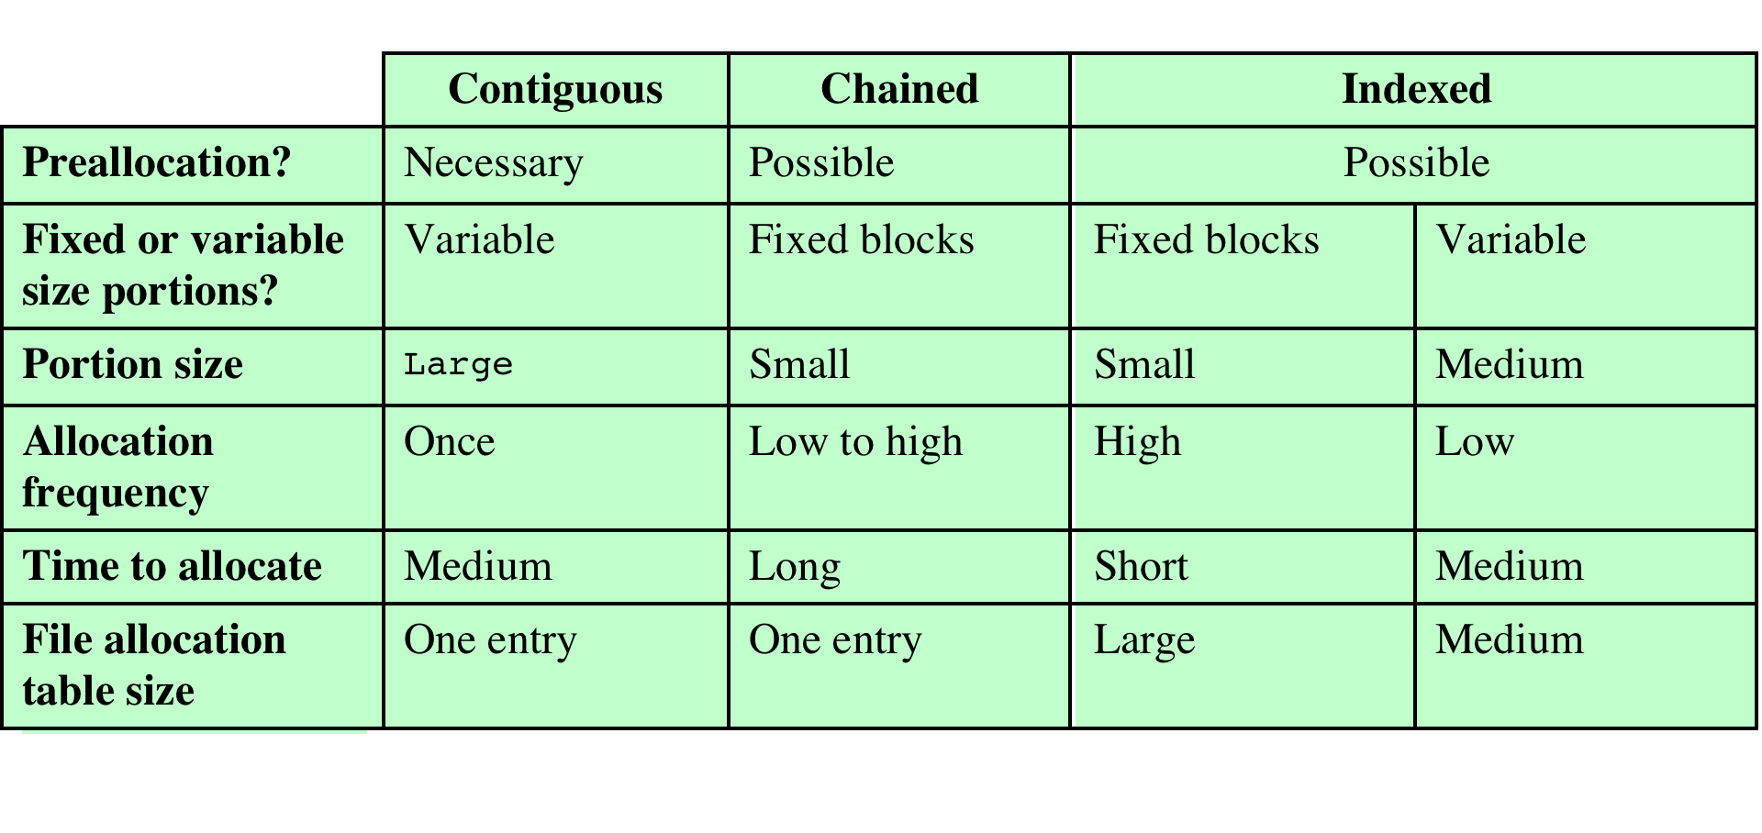
Comparison of file allocation methods

Slide 73
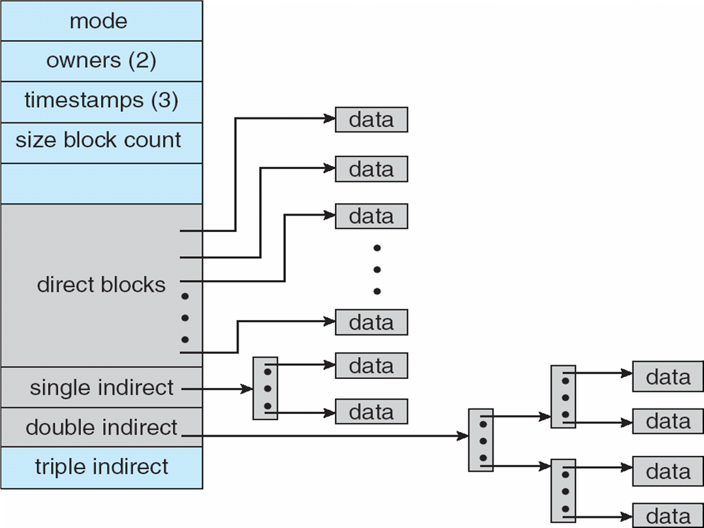
Combined Scheme: UNIX UFS (4K bytes per block)

Slide 74
Free-Space Management (1)
Bit vector (n blocks)
0
1
2
n-1
…
0 ⇒ block[i] free
1 ⇒ block[i] occupied

bit[i] =
Block number calculation
(number of bits per word) *
(number of 0-value words) +
offset of first 1 bit

Slide 75
Free-Space Management (2)
Bit map requires extra space. For example:
block size = 2¹² bytes
disk size = 2³⁰ bytes (1 gigabyte)
n = 2³⁰/2¹² = 2¹⁸ bits (or 32K bytes)
Easy to get contiguous files.
Linked list (free list):
Cannot get contiguous space easily.
No waste of space.
Grouping
Counting

Slide 76
Free-Space Management (3)
Need to protect:
Pointer to free list.
Bit map:
Must be kept on disk.
Copy in memory and disk may differ.
Cannot allow for block[i] to have a situation where bit[i] = 1 in memory and bit[i] = 0 on disk.
Solution:
Set bit[i] = 1 in disk.
Allocate block[i].
Set bit[i] = 1 in memory.

Slide 77
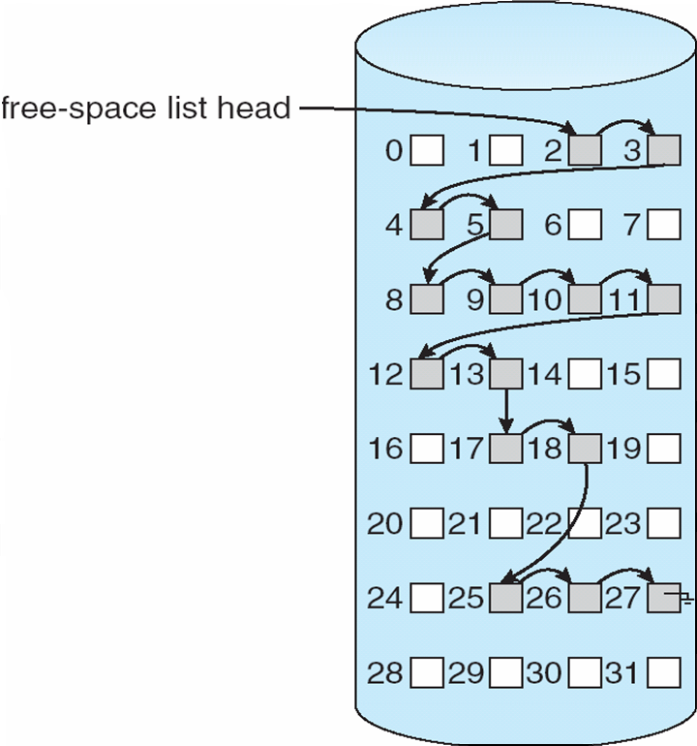
Linked Free Space List on Disk

Slide 78
Directory Implementation
Linear list of file names with pointer to the data blocks:
simple to program
time-consuming to execute
Hash Table – linear list with hash data structure:
decreases directory search time
collisions – situations where two file names hash to the same location
fixed size

Slide 79
Efficiency and Performance
Efficiency dependent on:
Disk allocation and directory algorithms.
Types of data kept in file’s directory entry.
Performance:
Disk cache: separate section of main memory for frequently used blocks.
Free-behind and read-ahead: techniques to optimize sequential access.
Improve PC performance by dedicating section of memory as virtual disk or RAM disk.

Slide 80
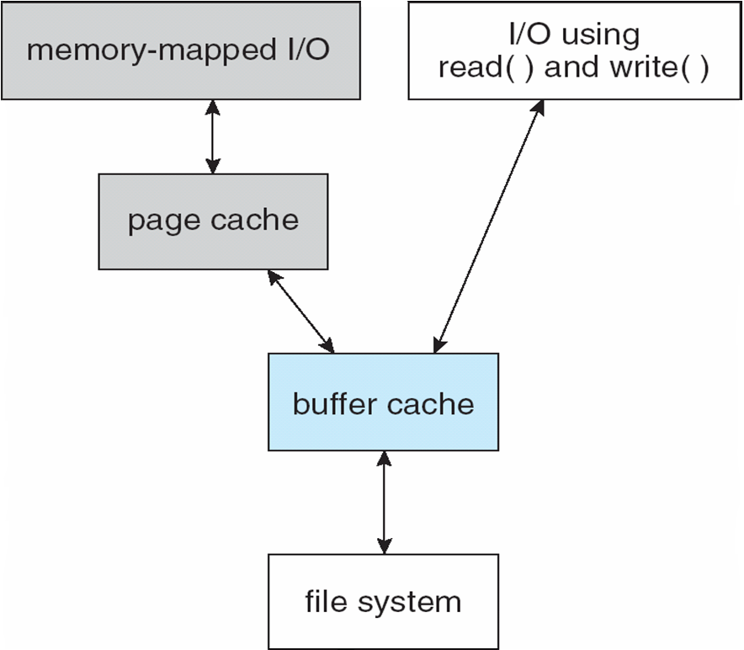
Page Cache
A page cache caches pages rather than disk blocks using virtual memory techniques.
Memory-mapped I/O uses a page cache.
Routine I/O through the file system uses the buffer (disk) cache.

Slide 81
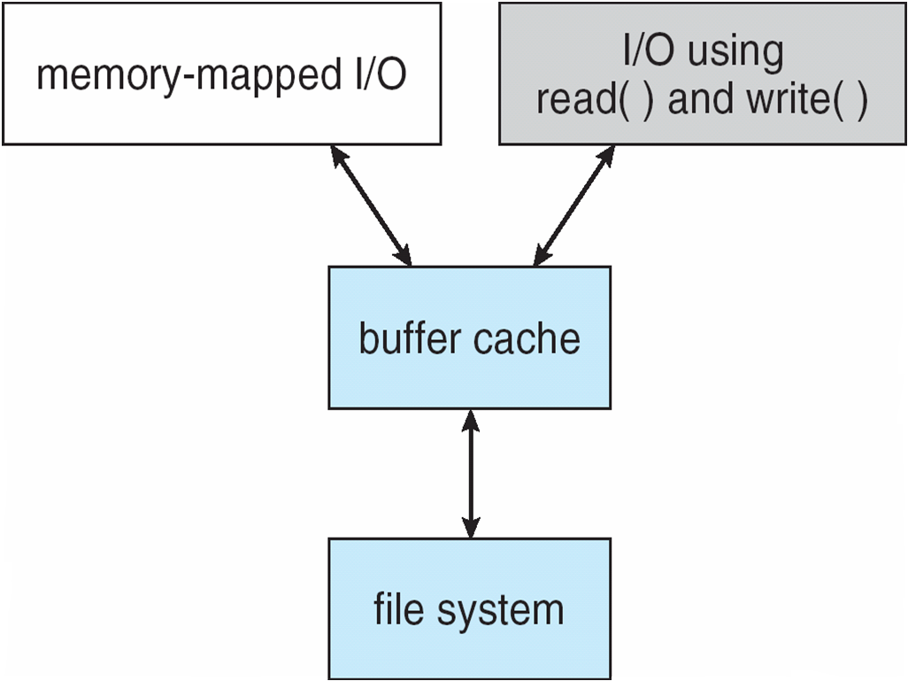
Unified Buffer Cache
A unified buffer cache uses the same page cache to cache both memory-mapped pages and ordinary file system I/O.

Slide 82
Recovery
Consistency checking – compares data in directory structure with data blocks on disk, and tries to fix inconsistencies.
Use system programs to back up data from disk to another storage device (floppy disk, magnetic tape).
Recover lost file or disk by restoring data from backup.

Slide 83
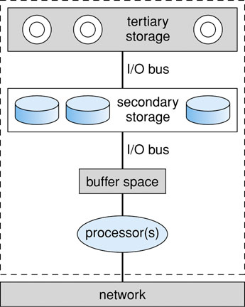
Storage Backup

Slide 84
Disk Scheduling

Slide 85
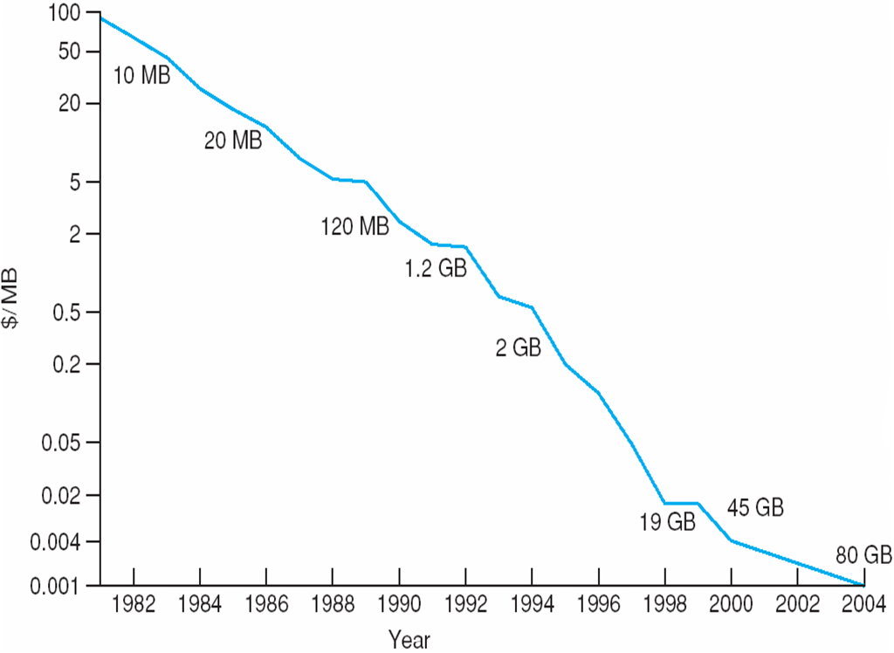
Price per Megabyte of Magnetic Hard Disk, From 1981 to 2004
Notes:
85

Slide 86
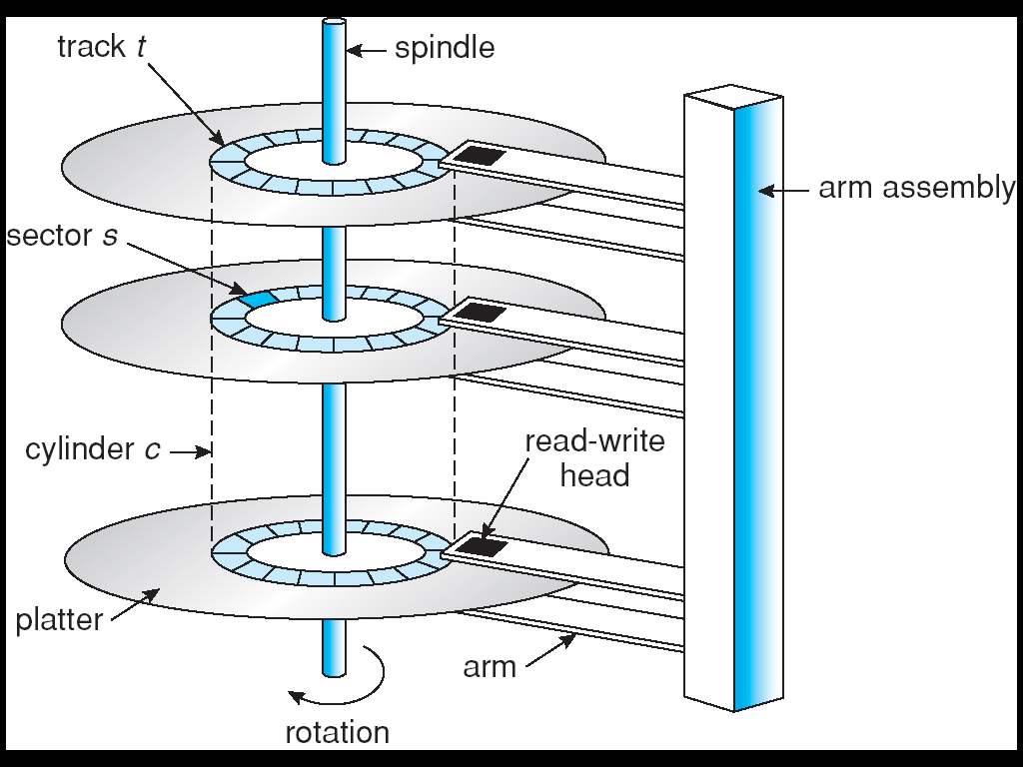
Moving-head Disk Mechanism
Notes:
86

Slide 87
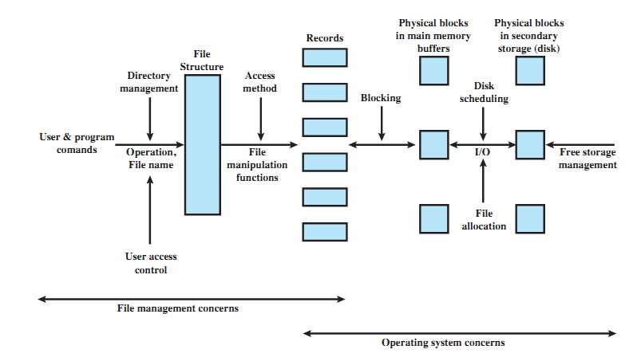
Elements of File Management
Notes:
87

Slide 88
Disk Scheduling (1)
The operating system is responsible for using hardware efficiently — for the disk drives, this means having a fast access time and disk bandwidth.
Access time has two major components:
Seek time is the time for the disk are to move the heads to the cylinder containing the desired sector.
Rotational latency is the additional time waiting for the disk to rotate the desired sector to the disk head.
Minimize seek time ≈ seek distance.
Disk bandwidth is the total number of bytes transferred, divided by the total time between the first request for service and the completion of last transfer.

Slide 89
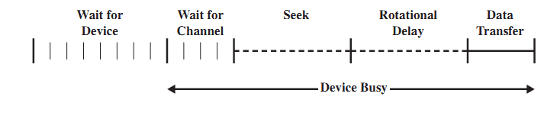
Components of Disk I/O Transfer
Notes:
89

Slide 90
Disk Scheduling (2)
There are many sources of disk I/O request:
OS
System processes
Users processes
I/O request includes input/output mode, disk address, memory address, number of sectors to transfer.
OS maintains queue of requests, per disk or device.
Idle disk can immediately work on I/O request, busy disk means work must queue:
Optimization algorithms only make sense when a queue exists.

Slide 91
Disk Structure
Disk drives are addressed as large 1-dimensional arrays of logical blocks, where the logical block is the smallest unit of transfer.
The 1-dimensional array of logical blocks is mapped into the sectors of the disk sequentially:
Sector 0 is the first sector of the first track on the outermost cylinder.
Mapping proceeds in order through that track, then the rest of the tracks in that cylinder, and then through the rest of the cylinders from outermost to innermost.

Slide 92
Disk Scheduling Algorithms
Note that drive controllers have small buffers and can manage a queue of I/O requests (of varying “depth”).
Several algorithms exist to schedule the servicing of disk I/O requests.
The analysis is true for one or many platters.
We illustrate them with a I/O request queue (cylinders are between 0-199): queue = 98, 183, 37, 122, 14, 124, 65, 67
head starts at 53

Slide 93
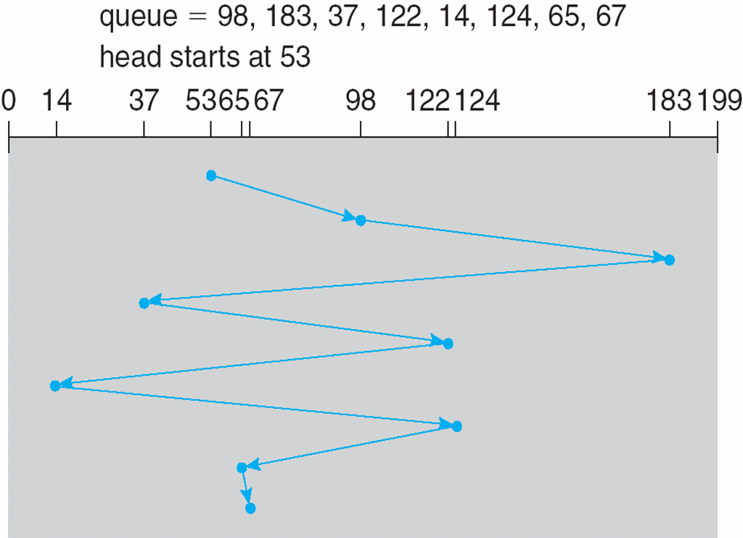
First Come First Serve (FCFS) Example
Illustration shows total head movement of 640 cylinders.

Slide 94
First Come First Serve (FCFS)
Handle I/O requests sequentially.
Fair to all processes.
Approaches random scheduling in performance if there are many processes/requests.
Suffers from global zigzag effect.

Slide 95
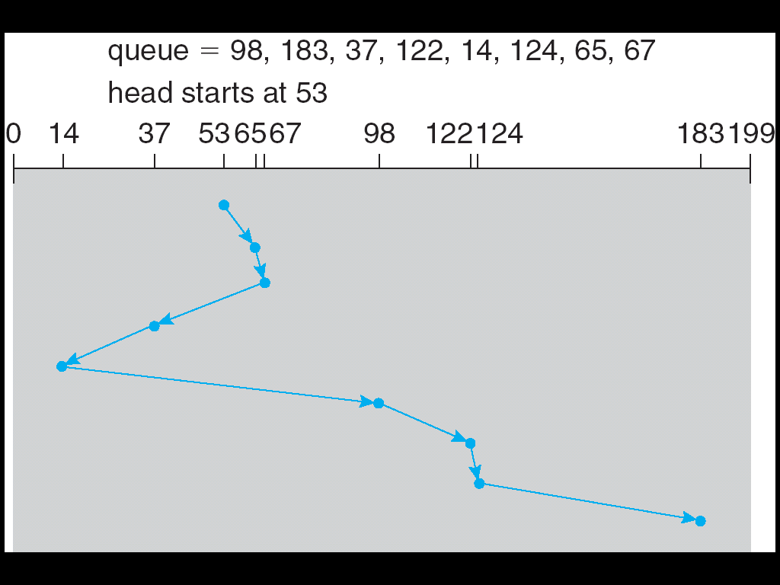
Shortest Seek Time First (SSTF) Example
Illustration shows total head movement of 236 cylinders.

Slide 96
Shortest Seek Time First (SSTF)
Selects the request with the minimum seek time from the current head position.
Also called Shortest Seek Distance First (SSDF) – It’s easier to compute distances.
It’s biased in favor of the middle cylinders requests.
SSTF scheduling is a form of SJF scheduling; may cause starvation of some requests.

Slide 97
Elevator Algorithms
Algorithms based on the common elevator principle.
Four combinations of Elevator algorithms:
– Service in both directions or in only one direction.
– Go until last cylinder or until last I/O request.
Go until
Go until the
last request
Direction
Go until the
last cylinder
Service both
directions
Scan
Look
Service in only
one direction
C-Scan
C-Look

Slide 98
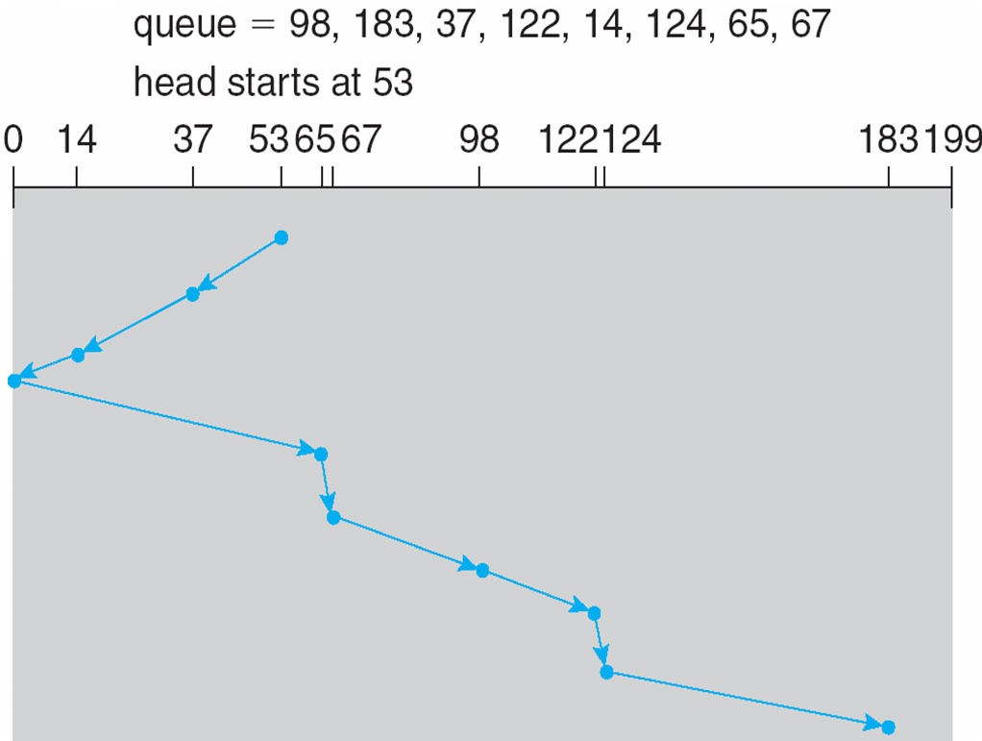
Scan Example
Illustration shows total head movement of 208 cylinders.

Slide 99
Scan
The disk arm starts at one end of the disk, and moves toward the other end, servicing requests until it gets to the other end of the disk, where the head movement is reversed and servicing continues.
It moves in both directions until both ends.
Tends to stay more at the ends so more fair to the extreme cylinder requests.

Slide 100
Look
The disk arm starts at the first I/O request on the disk, and moves toward the last I/O request on the other end, servicing requests until it gets to the other extreme I/O request on the disk, where the head movement is reversed and servicing continues.
It moves in both directions until both last I/O requests; more inclined to serve the middle cylinder requests.

Slide 101
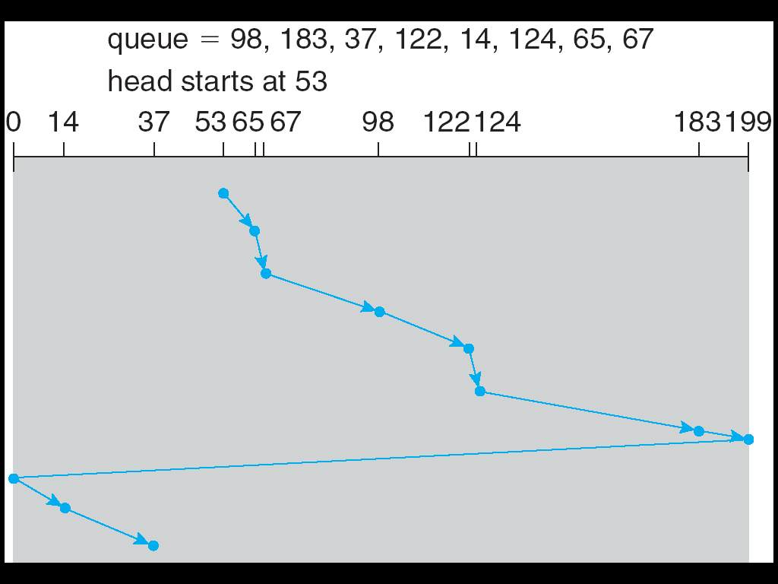
C-Scan Example

Slide 102
C-Scan
The head moves from one end of the disk to the other, servicing requests as it goes. When it reaches the other end, however, it immediately returns to the beginning of the disk, without servicing any requests on the return trip.
Treats the cylinders as a circular list that wraps around from the last cylinder to the first one.
Provides a more uniform wait time than SCAN; it treats all cylinders in the same manner.

Slide 103

C-Look Example

Slide 104
C-Look
Look version of C-Scan.
Arm only goes as far as the last request in each direction, then reverses direction immediately, without first going all the way to the end of the disk.
In general, Circular versions are more fair but pay with a larger total seek time.
Scan versions have a larger total seek time than the corresponding Look versions.

Slide 105

Another Example
LOOK
C-LOOK

Slide 106

Graphs for previous example
LOOK
C-LOOK

Slide 107
Other Disk Scheduling Policies
Pickup
A combination of FCFS and Look.
Goes to next I/O request by FCFS but services all existing requests on the way to it.
Priority
Goal is not to optimize disk use but to meet other objectives.
Short batch jobs may have higher priority.
Provide good interactive response time.

Slide 108
Scan Algorithm Variations
FScan
Use two queues.
One queue is empty to receive new requests.
N-step-Scan
Segments the disk request queue into subqueues of length N.
Subqueues are processed one at a time, using Scan.
New requests added to other queue when a certain queue is processed.

Slide 109
Selecting a Disk-Scheduling Algorithm (1)
Performance depends on the number and types of requests.
Requests for disk service can be influenced by the file-allocation method.
The disk-scheduling algorithm should be written as a separate module of the operating system, allowing it to be replaced with a different algorithm if necessary.

Slide 110
Selecting a Disk-Scheduling Algorithm (2)
With low load on the disk, It’s FCFS anyway.
SSTF is common and has a natural appeal – good for medium disk load.
SCAN and C-SCAN perform better for systems that place a heavy load on the disk; Less starvation.
Performance depends on number and types of requests.
Requests for disk service can be influenced by the file-allocation method and metadata layout.
Either SSTF or LOOK (as part of an Elevator package) is a reasonable choice for the default algorithm.

Slide 111


